Slide 1
E-Voting System
Batch 2021-5769
Enrollment Number | Name of the Student
EBEON0721406149 | Vishnu.M

Slide 2
E-Voting System
Contents:
Introduction
Modules
Technologies
Advantages
Conclusion

Slide 3
INTRODUCTION:
In this project we will see about casting our votes through online without going to the polling stations.
E-Voting System helps people who cannot be physically available at polling stations.
This system ensures only one vote per person i.e., no duplicate votes can be casted.

Slide 4
Modules:
Home
Admin
Visitor
Party Description

Slide 5
Homepage:
Homepage will be visible for all the people who visit the website

Slide 6
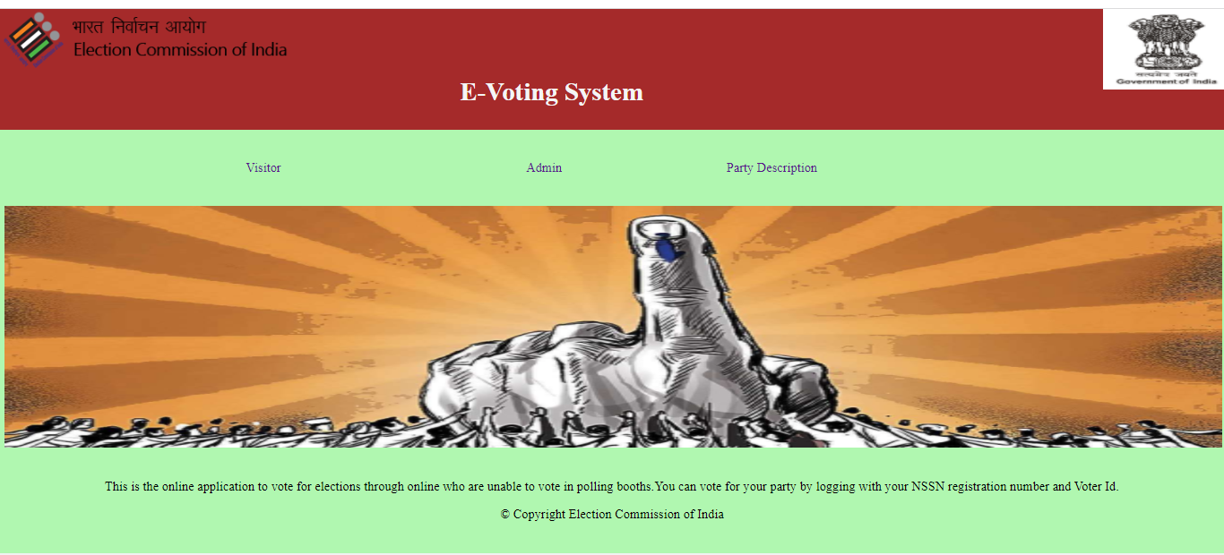
Homepage:

Slide 7
Visitor:
Visitors or general public will login here using their registered email id and password.

Slide 8
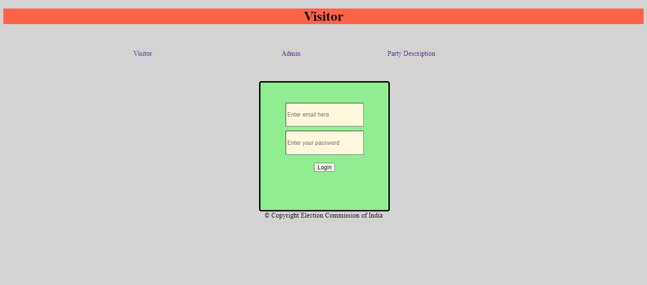
Visitor page:

Slide 9
Admin:
Administrators will login using their registered id and password.

Slide 10
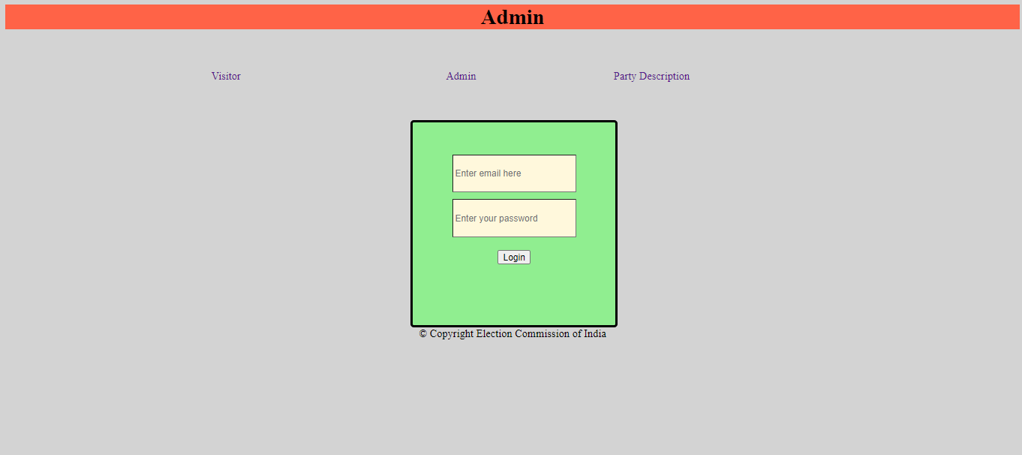
Admin page:

Slide 11
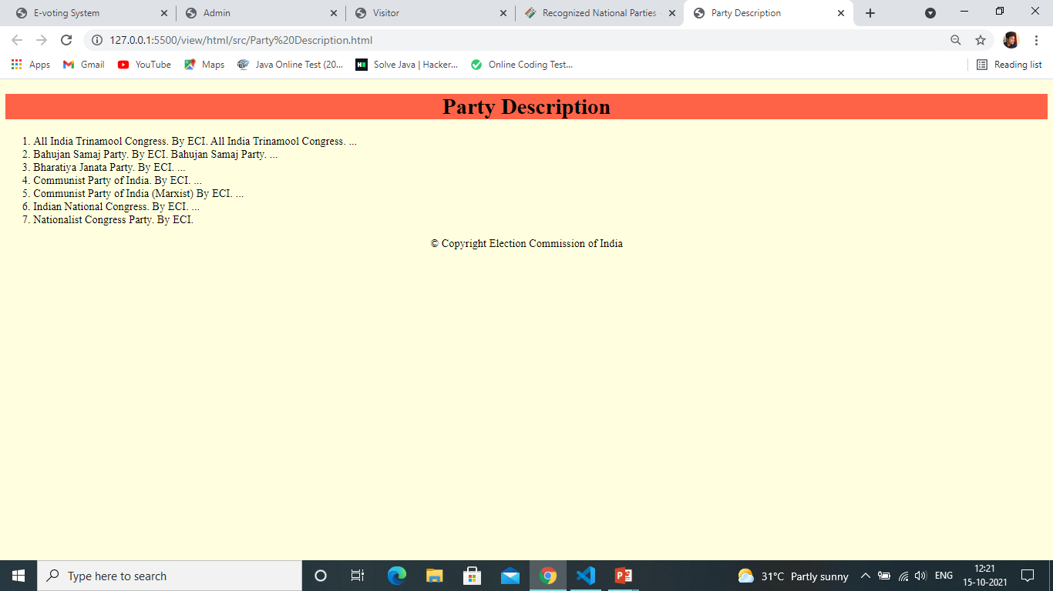
Party Description:

Slide 12
Technologies:
HTML
CSS

Slide 13
Advantages:
People can cast their vote through this website during this global pandemic at home.
Easier than casting votes in polling booths.
Can be done from anywhere and anytime.
Saves time and money.
Safe and secure.

Slide 14
Conclusion:
As a conclusion we can cast our votes through online at ease from our home.

Slide 15
Thank you

